Slide 1
Outline
Design Projects
Multi-layer Perceptron (MLP) Neural Network for Machine Learning

Slide 2
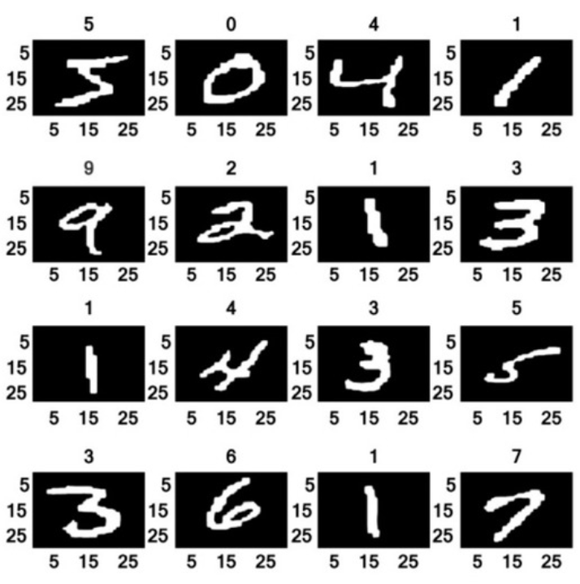
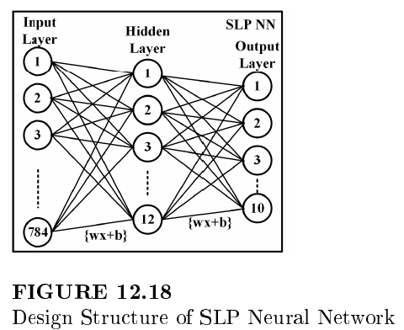
Multi-Layer Perceptron Neural Network
Handwritten digit recognition
Task: Classify a given image of a handwritten digit into one of 10.
Dataset: Modified National Institute of Standards and Technology (MNIST), including 60,000 28×28 pixel grayscale images of handwritten single digits between 0 and 9.
Multi-Layer Perceptron (MLP) Neural Network

Slide 3
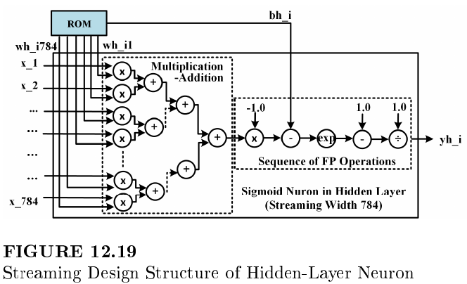
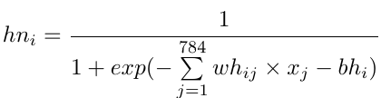
Sigmoid Neuron Design
Design on MLP Neural Network
The MLP neural network can be decomposed into multiple layers of sigmoid neurons
Each sigmoid neuron can be further decomposed into multiple floating-point (FP) operations such as FP adders and multipliers.
Sigmoid neuron design using FP operators
From hardware design specification, the sigmoid neuron can be constructed/integrated using FP units (FPUs)
Hardware design architecture should be considered

Slide 4
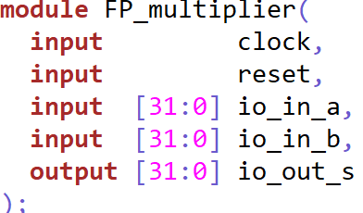
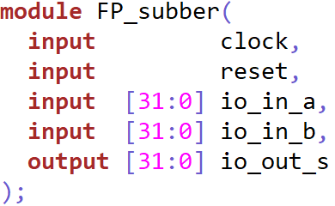
Project Requirements
Project #1: Design Integration and Simulation on FP Multiplier-Subtractor (MS)
Include the FPU_ls_lib.v into your project.
Notice that all the FP designs are asynchronous negedge reset.
Design the fp_ms using the FP multiplier and FP subtractor as design intellectual properties (IPs)
Notes:
The results should be -10.0 and 8.0

Slide 5
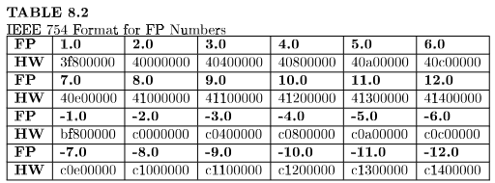
Project Requirements
Project #1: Design Integration and Simulation on FP Multiplier-Subtractor (MS)
Build the simulation environment with test cases below:
One input to the FP multiplier is -1.0
Feeding in pipelined/consecutive FP 12.0 and -10.0 (dot product) to the multiplier
Feeding in pipelined/consecutive FP -2.0 and 2.0 (bias bh_i) to the subtractor
Notes:
The results should be -10.0 and 8.0

Slide 6
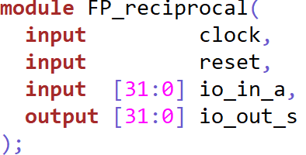
Project Requirements
Project #2: Design Integration and Simulation on FP Sequence of Multiplier-Subtractor-Subtractor-Reciprocal (MSSR)
Design the fp_mssr by adding the FP subtractor and FP reciprocal to the Project 1.
Notice that all the FP designs are asynchronous negedge reset.
Notes:
The results should be -1.0/11.0=-0.0909 and 1.0/7.0=0.1428

Slide 7
Project Requirements
Project #2: Design Integration and Simulation on FP sequence of Multiplier-Subtractor-Subtractor-Reciprocal (MSSR)
Build the simulation environment with test cases below:
Testing io_a-1.0 for the second FP subtractor
Testing 1.0/io_a for the FP reciprocal
Feeding in pipelined/consecutive FP 12.0 and -10.0 (dot product) to the multiplier
Feeding in pipelined/consecutive FP -2.0 and 2.0 (bias bh_i) to the subtractor
Notes:
The results should be -1.0/11.0=-0.0909 and 1.0/7.0=0.1428

Slide 8
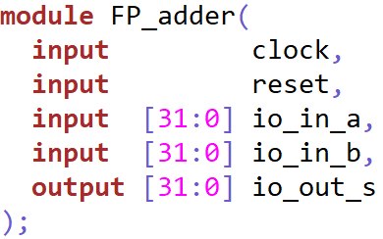

Project Requirements
Project #3: Design Integration and Simulation on FP Dot Product
Include the FPU_ls_lib.v into your project
Design the fp_dot using the FP multiplier and FP adder as design intellectual properties (IPs)
The streaming width is four, meaning the input vector size is 4
$$z=\left[w0,w1,w2,w3\right]∗\left[\begin{aligned}x0 \\ x1 \\ x2 \\ x3\end{aligned}\right]$$

Slide 9
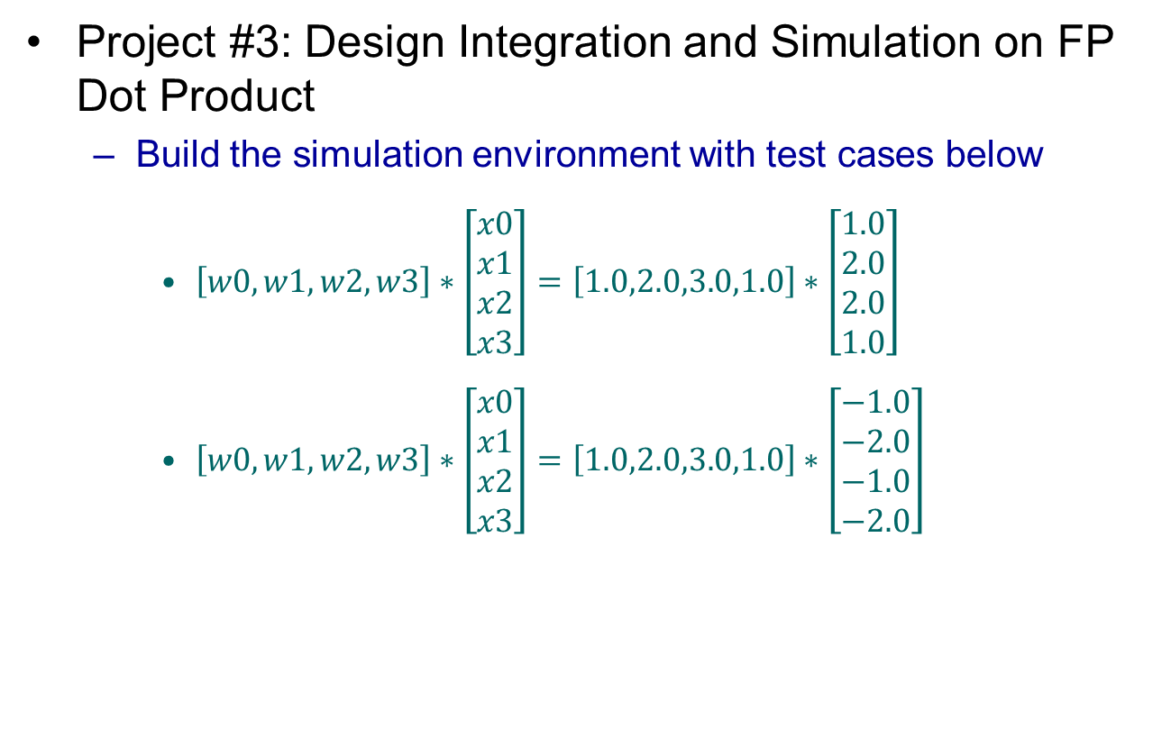
Project Requirements
Project #3: Design Integration and Simulation on FP Dot Product
Build the simulation environment with test cases below
$\left[w0,w1,w2,w3\right]∗\left[\begin{aligned}x0 \\ x1 \\ x2 \\ x3\end{aligned}\right]=\left[1.0,2.0,3.0,1.0\right]∗\left[\begin{aligned}1.0 \\ 2.0 \\ 2.0 \\ 1.0\end{aligned}\right]$
$\left[w0,w1,w2,w3\right]∗\left[\begin{aligned}x0 \\ x1 \\ x2 \\ x3\end{aligned}\right]=\left[1.0,2.0,3.0,1.0\right]∗\left[\begin{aligned}−1.0 \\ −2.0 \\ −1.0 \\ −2.0\end{aligned}\right]$
Notes:
The results should be 12.0 and -10.0

Slide 10
Project Requirements
Project #4: Design Integration and Simulation on a sigmoid neuron using the FPUs provided.
Integrate project 2 and 3 as the sigmoid neuron

Slide 11
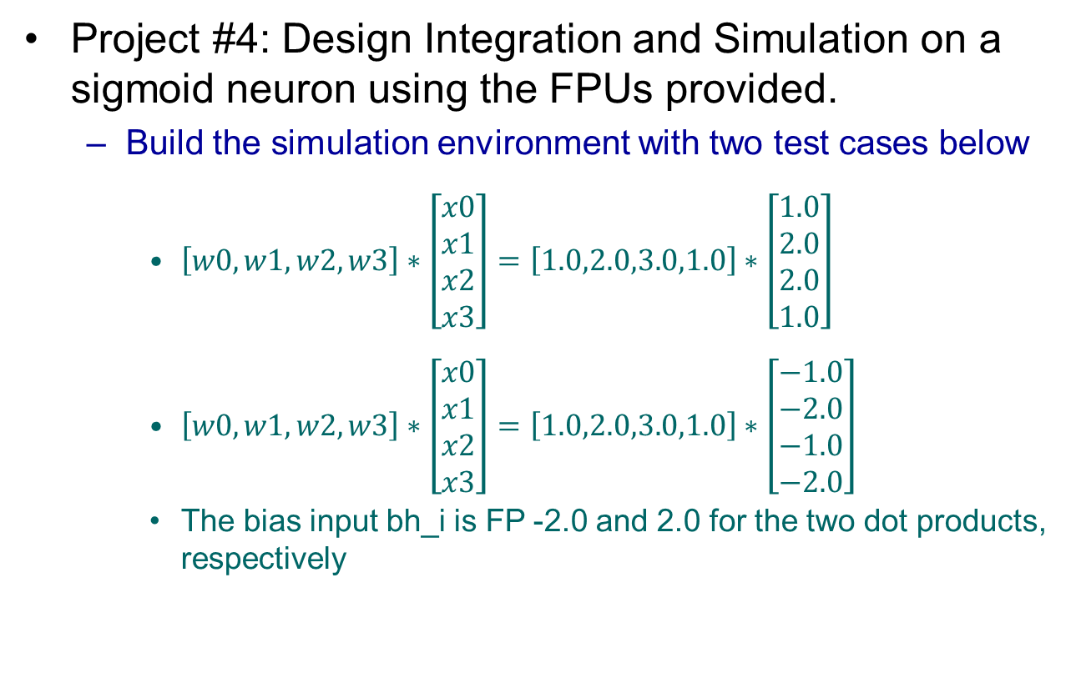
Project Requirements
Project #4: Design Integration and Simulation on a sigmoid neuron using the FPUs provided.
Build the simulation environment with two test cases below
$\left[w0,w1,w2,w3\right]∗\left[\begin{aligned}x0 \\ x1 \\ x2 \\ x3\end{aligned}\right]=\left[1.0,2.0,3.0,1.0\right]∗\left[\begin{aligned}1.0 \\ 2.0 \\ 2.0 \\ 1.0\end{aligned}\right]$
$\left[w0,w1,w2,w3\right]∗\left[\begin{aligned}x0 \\ x1 \\ x2 \\ x3\end{aligned}\right]=\left[1.0,2.0,3.0,1.0\right]∗\left[\begin{aligned}−1.0 \\ −2.0 \\ −1.0 \\ −2.0\end{aligned}\right]$
The bias input bh_i is FP -2.0 and 2.0 for the two dot products, respectively

Slide 12
Evaluation Rubric
Grading rubric
Submit your report and the project to Canvas
In the report, include screenshots of your design code, testbench, and simulation results as attachments.
Grading policy
Introduction and conclusion (2 pts)
Design code (2 pts)
Testbench (1 pt)
Simulation results
All the signals must be clearly shown in the screenshot waveform (2 pts)
The FP inputs and outputs must be shown in float32 format (1 pts)
The correctness of the simulation results (2 pts)

Slide 13
Thanks!
CRC Publisher Book: Integrated Circuit Design
Associate Professor, UHCL
yangxia@uhcl.edu
Affiliate Faculty, LBL
xiaokunyang@lbl.gov

